Slide 1

Flash Talk – Evogames in Python
Or how I travelled through time on User Interfaces
github.com/cromlyngames/stos-valley

Slide 2
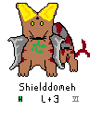
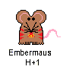
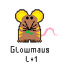
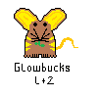
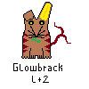
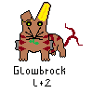
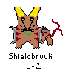
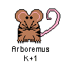


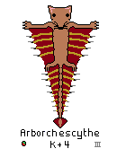
1990s : Pixel Valley
Pixel art done by hand,
Layout uses Graphviz
‘Story’ uses reddit comment chain format
Parent species chosen randomly
BUT new species ‘hand crafted’
‘Power’ improvement
Environmental improvement
Sexual competition improvement
New species ‘stress’ competitors
Extinction every ten species Stress > dice

Slide 3
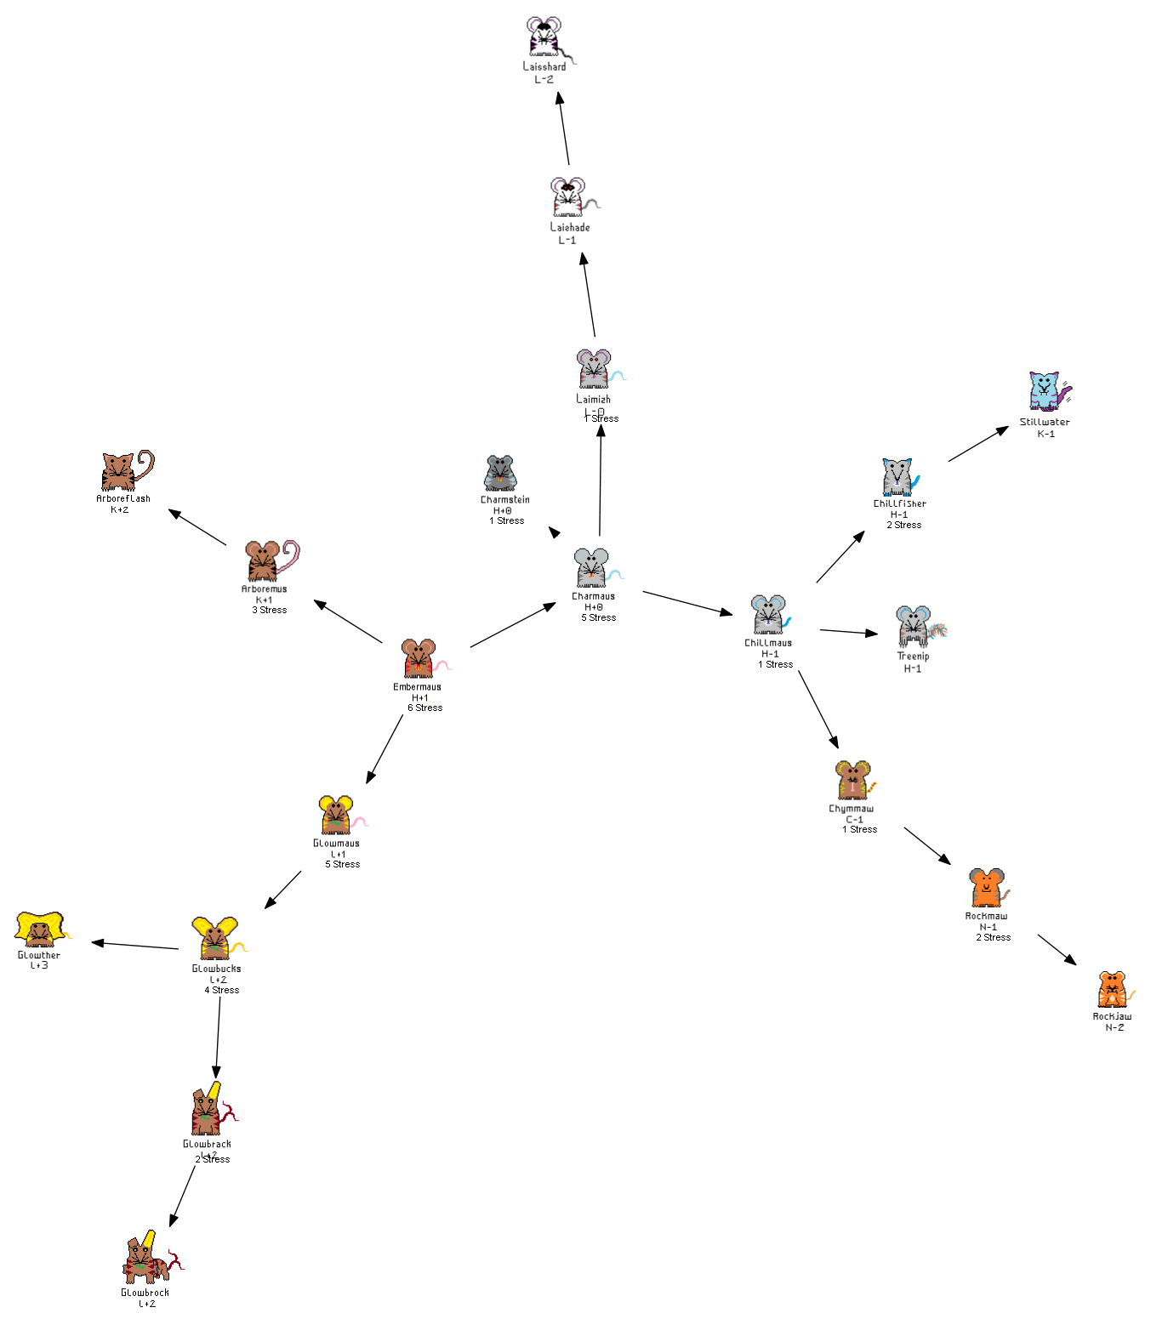

Slide 4
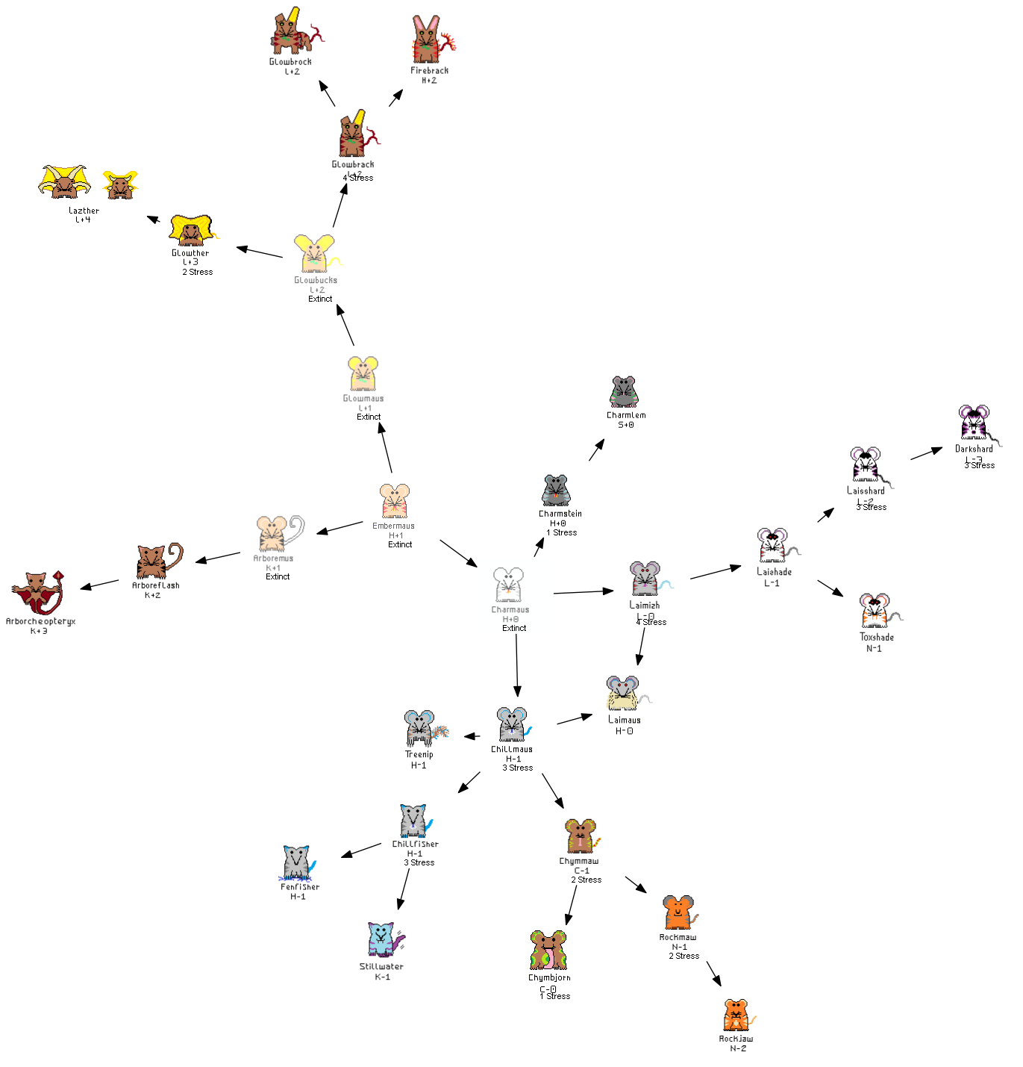

Slide 5
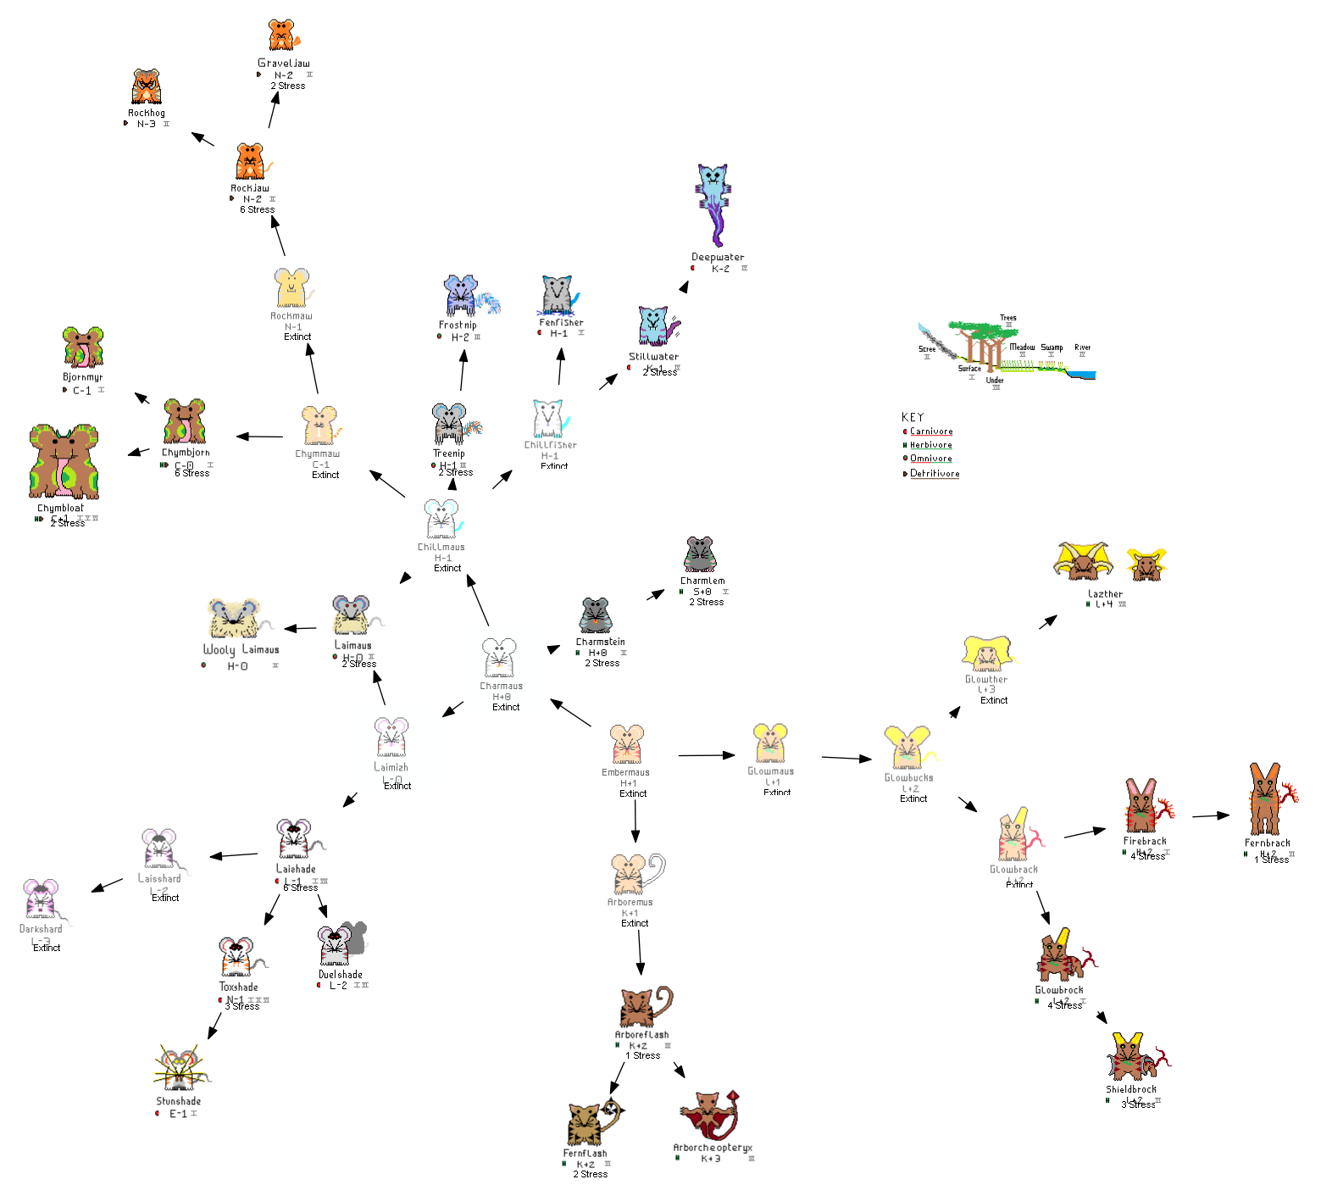

Slide 6
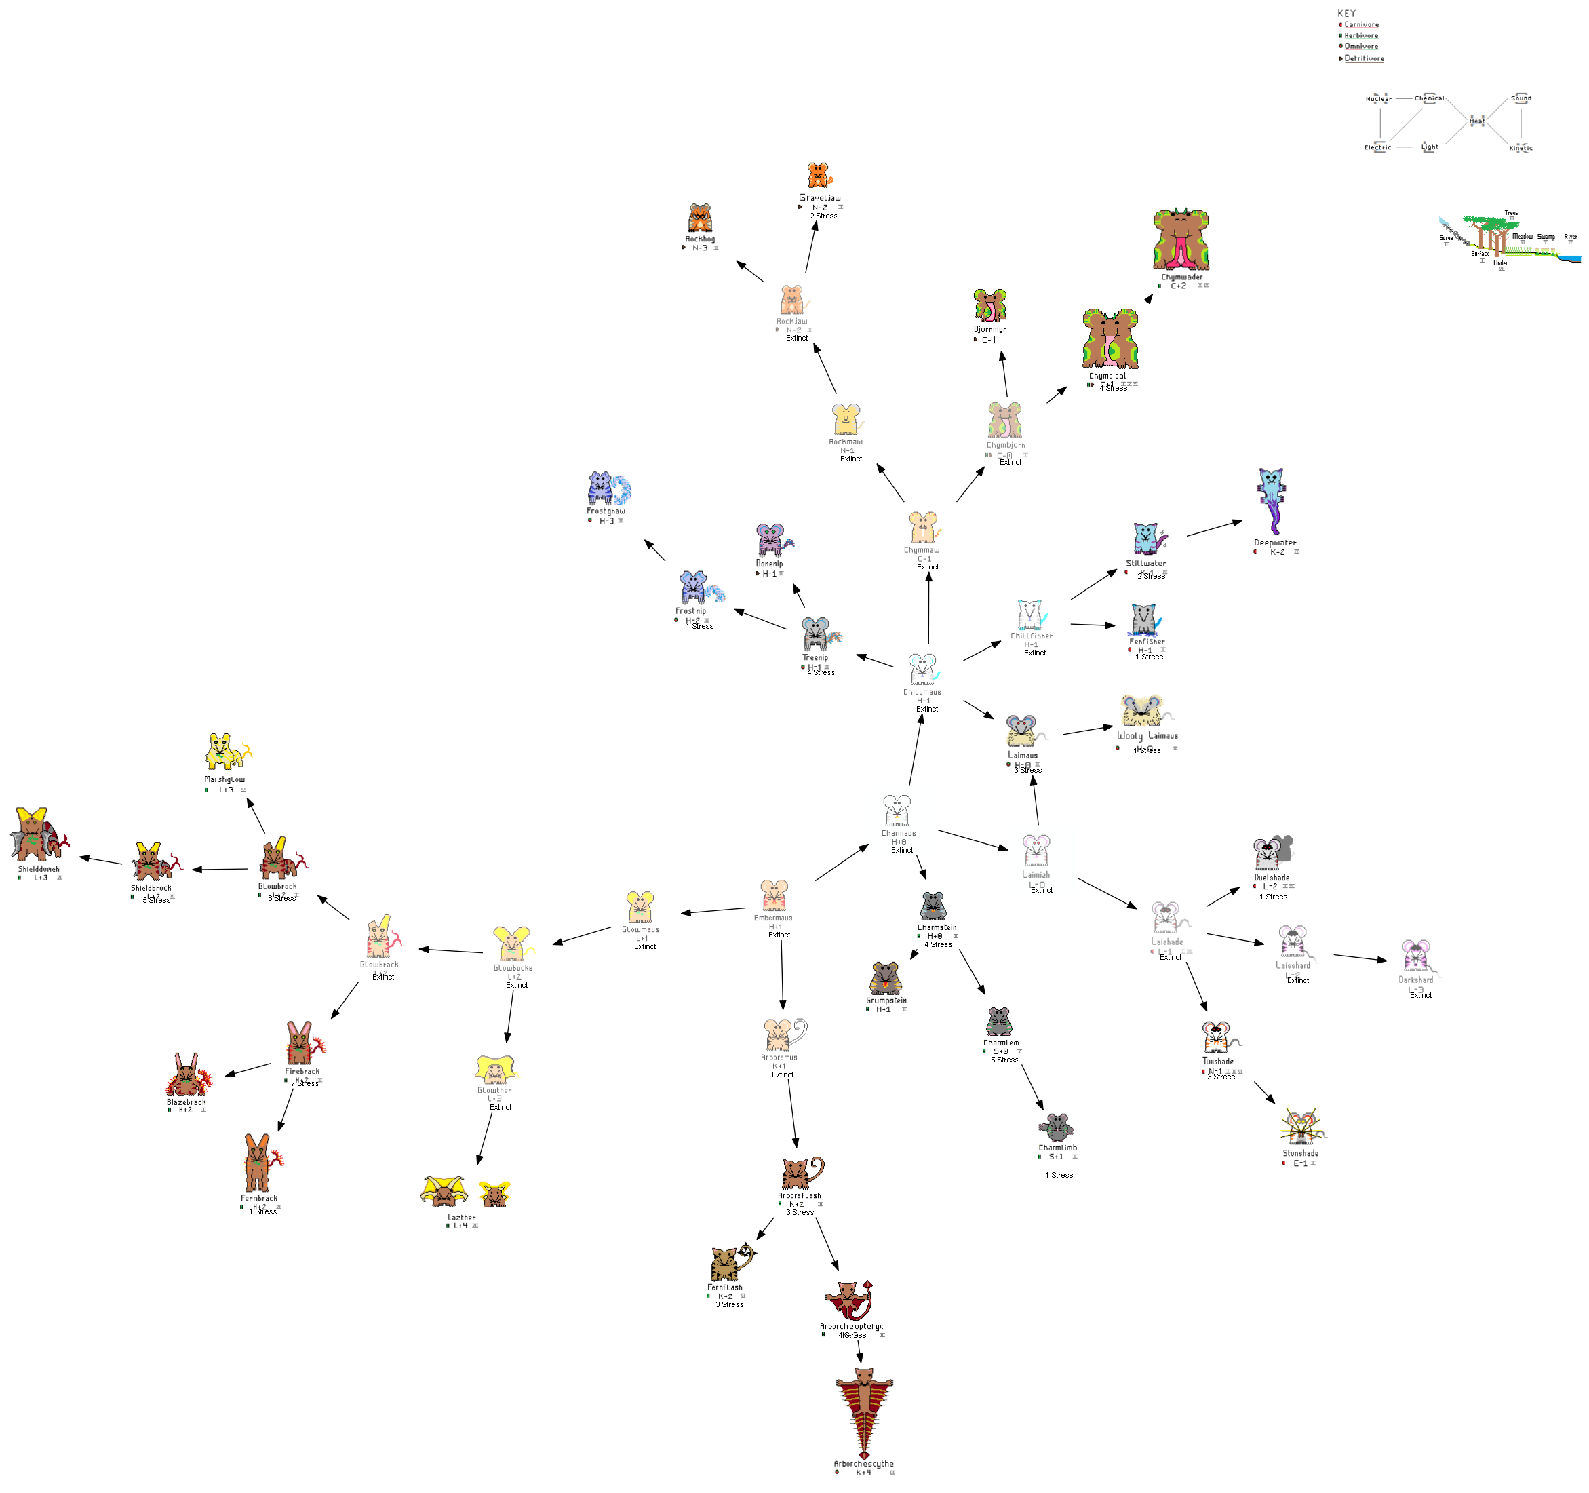

Slide 7
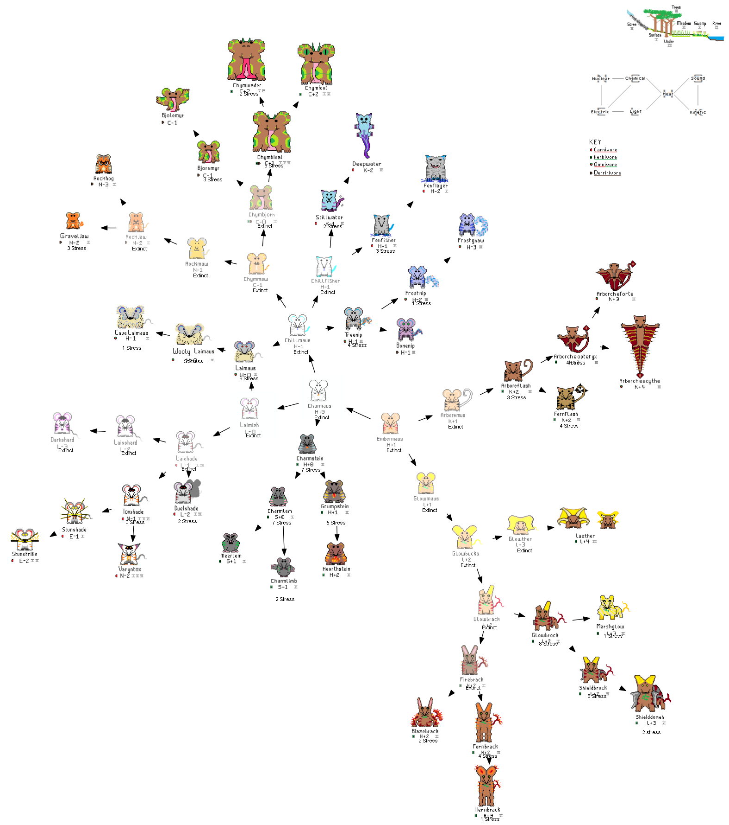

Slide 8
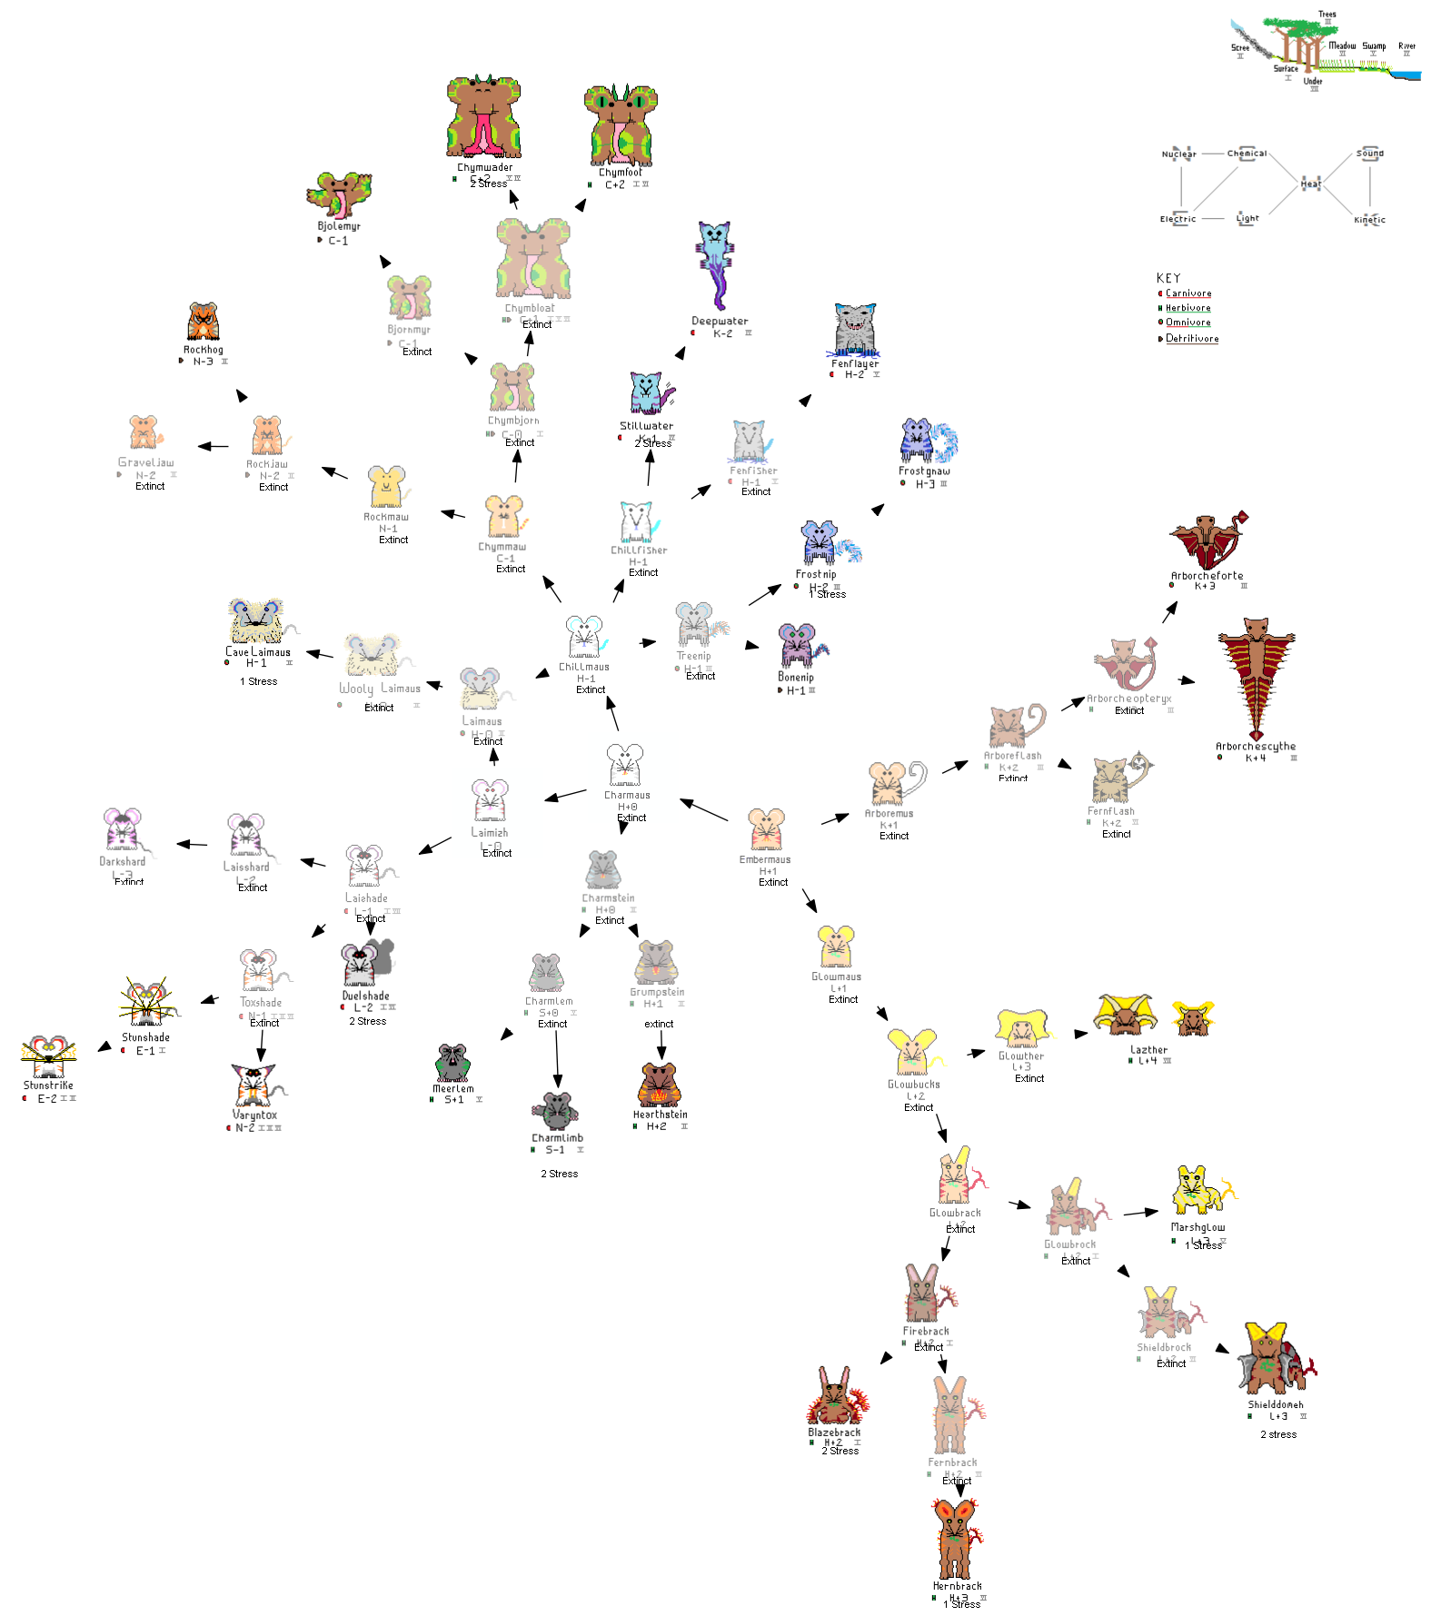

Slide 9
1980s - Python Eating Turtle Valley
Uses tkinter and the turtle module
Animal as sequence of lengths and angles.
Mutation +- 10% > eliminates all but useful
Emergent shape assessed:
preybonus = 1/3*(detailsbit['eyeratio']
+generikmon['crownD']
+detailsbit['fangtipratio'])
senseEval = 1/4*(detailsbit['eyesize']
+detailsbit['nosesize']
+ generikmon['ear2D']
+ generikmon['ear6D'])
github.com/cromlyngames/stos-valley / blob/master/turtledraawtest2.py

Slide 10
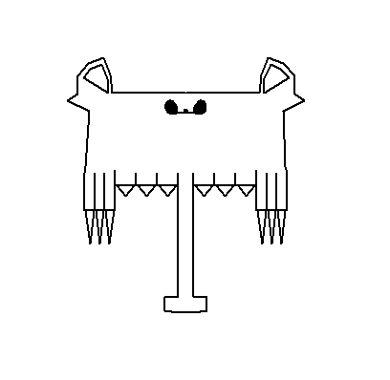
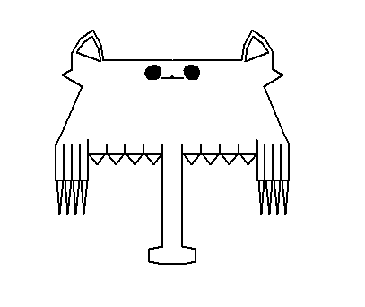
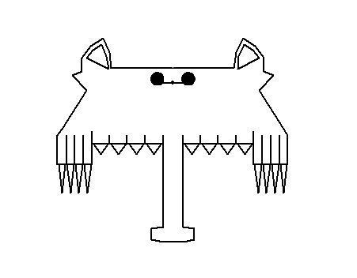
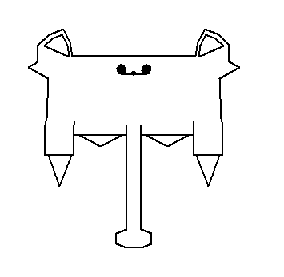
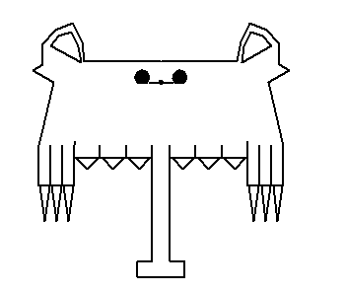
Evolving for prey bonus
But…
Turtle very slow
‘Cliff-edge’ fitness issues
Great for environment, but no interaction between species
github.com/cromlyngames/stos-valley / blob/master/turtledraawtest2.py

Slide 11
1970s: Fantasy Foodweb
Input: number of species, incoming energy
Ignores environment, focus on species interaction
Light_eater_compi = { 'SC': 'Quickly growing to full height',
'RK': 'Entangling climber',
'PA': 'Symbiotic Defender '}
Light_eater_defnd = { Herbi_eater_predi = {
'SC': 'Tall, high leaves', 'RK': 'Long neck/good climber/burrower',
'RK': 'Woody stems', 'PA': 'Specialised gut',
'PA': 'Sacrificial Fruits '} 'SC': 'Grinding maw/teeth/beak'}
github.com/cromlyngames/stos-valley / blob/master/fantasy-foodweb

Slide 12
Sample output
The Light_eater Crlia (10011) is noted for Quickly growing to full height, , , .
There are 52 of these head height, large bush sized growths in the area
The Light_eater Pidnky (10013) is noted for , , , nothing.
There are 4 of these hand size, potplant sized growths in the area
The Herbi_eater Marbil (50018) is noted for , Specialised gut, , .
There are 17 of these medium, fox sized browsers in the area
when threatened it will Sense and avoid
The Herbi_eater Rattlater (50022) is noted for Loud warning calls, Specialised gut, Fast and nimble, .
There are 19 of these medium, fox sized browsers in the area
when threatened it will Flee from danger
github.com/cromlyngames/stos-valley / blob/master/fantasy-foodweb

Slide 13
Problems
No environmental adaptations
No feedback to environment (daisy world or beavers)
Poor scaling – inevitable?
Not PEP 8 compliant. Refactor and try again.
Carnivore tango
NO PIXEL ART!
github.com/cromlyngames/stos-valley / blob/master/fantasy-foodweb

